Slide 1

DIGITAL PORTFOLIO
STUDENT NAME:
REGISTER NO AND NMID:
DEPARTMENT:
COLLEGE: COLLEGE/UNIVERSITY
Hemalatha V

Slide 2

PROJECT TITTLE
Ai in gaming🎮

Slide 3

AGENDA
1.Problem Statement
2. Project Overview
3.End Users
4. Tools and Technologies
5. Portfolio design and Layout
6. Features and Functionality
7.Results and Screenshots
8.Conclusion
9.Github Link

Slide 4
PROBLEM STATEMENT
The gaming industry is rapidly evolving, with increasing demand for immersive experiences, realistic environments, and intelligent gameplay. Traditional game design methods often struggle to meet player expectations due to limitations in pre-programmed behaviors, static difficulty levels, and repetitive gameplay patterns. Players seek dynamic, personalized, and adaptive experiences that respond to their actions in real time.

Slide 5
PROJECT OVERVIEW
project explores the role of Artificial Intelligence (AI) in revolutionizing the gaming industry.
** It focuses on how Al enhances player experiences, optimizes game development, and creates dynamic virtual worlds.

Slide 6
End user
3. Personalized Gameplay
***Al studies your choices and tailors storylines, levels, or loot drops.
Example: Games like RPGs adjust quests based on your play style.

Slide 7
TOOLS AND TECHNOLOGIES
Game Development Engines with Al Support:
>>>Unity ML-Agents: Toolkit for
°°training intelligent agents with reinforcement learning.
°°Unreal Engine (Al Tools): Behavior trees, perception systems, and navigation meshes for NPC AI.
°°Godot Engine (AI APIs):
°°Open-source engine with Al plugin support.

Slide 8
PORTFOLIO DESIGN AND LAYOUT
Cover page / Herosection
Introduction section
Table of Contents
Concepts pages
Showcase your your projects
Tech & Tool Section
Infographics Diagram
future Scope Section
Contact

Slide 9
Futures and functionality
🔶Functionality (Present Uses)
1. Smart NPCs that behave and react realistically.
2. Dynamic difficulty adjustment based on player skill.
🔸Future of Al in Gaming
1. NPCs with unique personalities, memories, and decision-making.
2. Hyper-realistic graphics powered by Al rendering (DLSS, GANs).

Slide 10
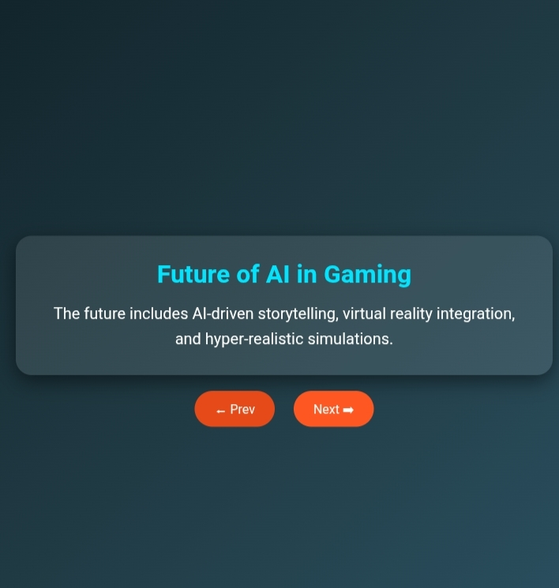
Result and screenshot
The future include AI-driven storytellling, virtual reality integration, and hyper-realistic simulations

Slide 11
Conclusion
With Al-driven testing, cheat detection, and analytics, games become more secure and well-balanced.
As Al continues to evolve, the future of gaming will feature even more immersive, adaptive, and creative experiences.

